Slide 1

Fetal Health Prediction
By Abdulaziz & Ibrahim

Slide 2

Problem - Importance
211 death per 100,000 live birth (2017).
Most could have been PREVENTED.

Slide 3



Problem - Goal
Classify fetal health in order to prevent child and maternal mortality.
Normal
Suspect
Pathological

Slide 4
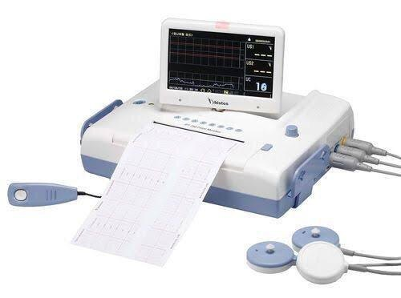
Data
Collected from Cardiotocograms (CTGs).
Labeled by 3 experts.

Slide 5

Data
21 feature
2126
record

Slide 6
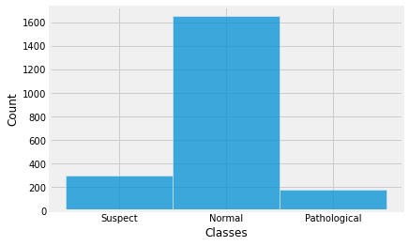
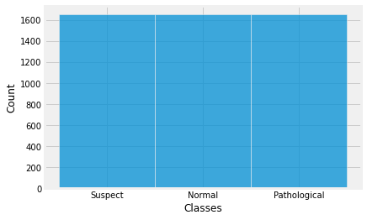
EDA – Balance Data (SMOTE)
Original y
Balanced Y

Slide 7
EDA – Cleaning ?
Duplicated | 24 rows
Missing Values | None
Outliers | None

Slide 8
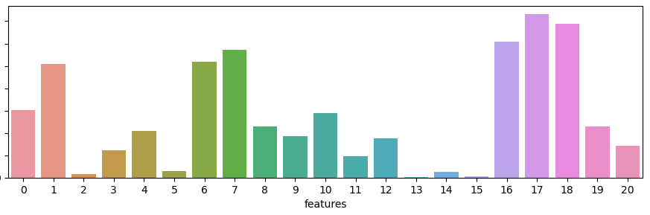
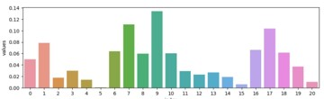
Feature Selection
Method 1 ANOVA
Method 2 Random Forest

Slide 9
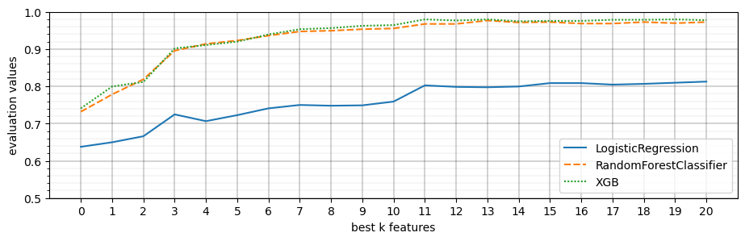
Feature Selection
Score vs N-Feature

Slide 10
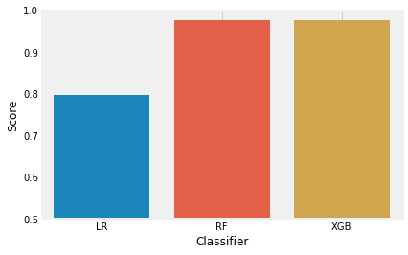
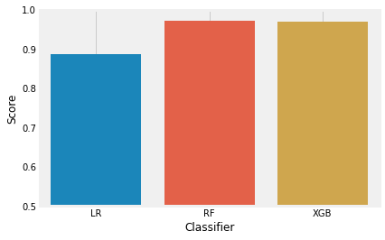
Finetuning - GridSearchCV
Before
After

Slide 11
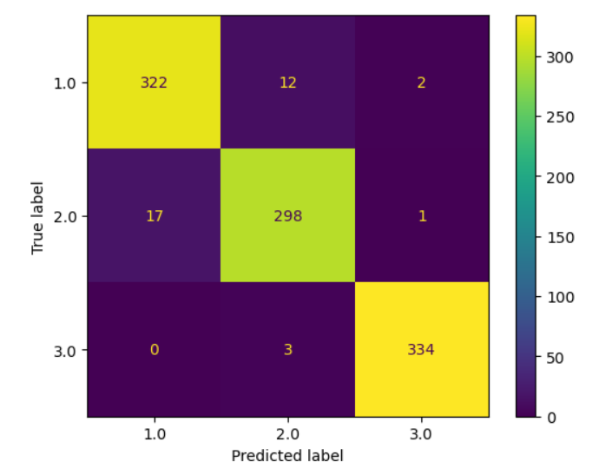
Results
XGBoost classifier
14 Features
Precission: 96.434 Recall 96.415 Accuracy: 96.461 ROC over AUC: 99.622

Slide 12
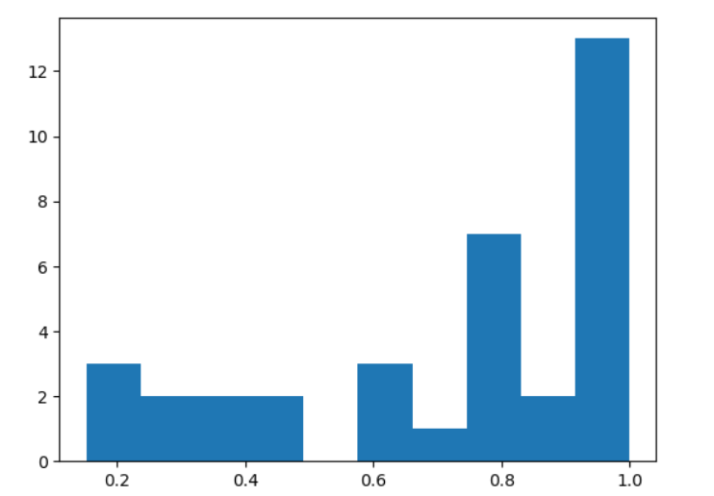
Results
Examining Misclassified probabilities differences
About 13 predictions were incorrectly classified with a very high confidence
Minimum difference of probability to other classes

Slide 13
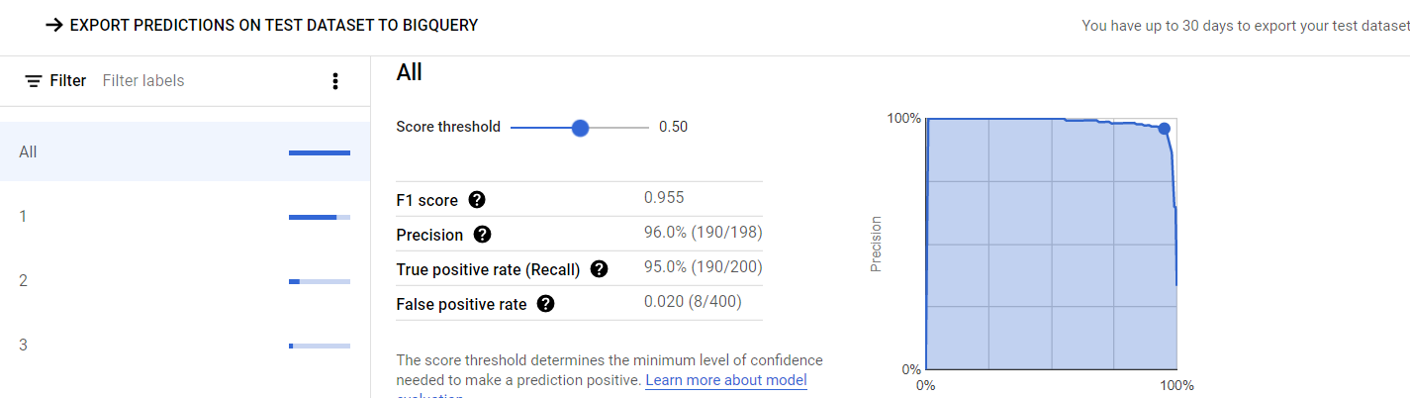
AutoML
AutoML is google cloud service that automatically find the best model and hyper parameter to use.

Slide 14
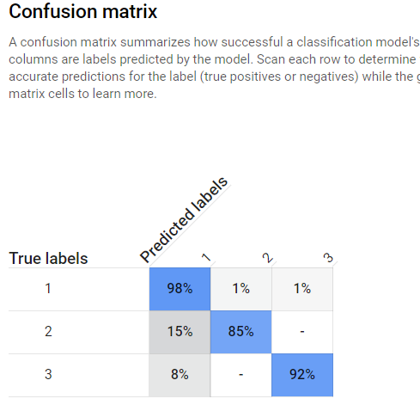
AutoML
Google Cloud AutoML
Our XGBoost model

Slide 15
Thank You

